Slide 1

Deep Dive into Service Mesh Data Plane Performance and Tuning
Lei Peng (@penglei) - Tencent
Lingpeng Chen (@ChenLingPeng) - Tencent

Slide 2



About us
Lei Peng(@penglei)
Lingpeng Chen(@chenlingpeng)
Senior Software Engineer at Tencent Cloud Service Mesh Team
Istio & Kubernetes Contributors
Tencent Cloud Mesh

Slide 3
What is Service Mesh?
A network infrastructure layer for microservice communication
Decouple operation from development
Flexible, reliable
Transparent
https://www.redhat.com/en/topics/microservices/what-is-a-service-mesh

Slide 4
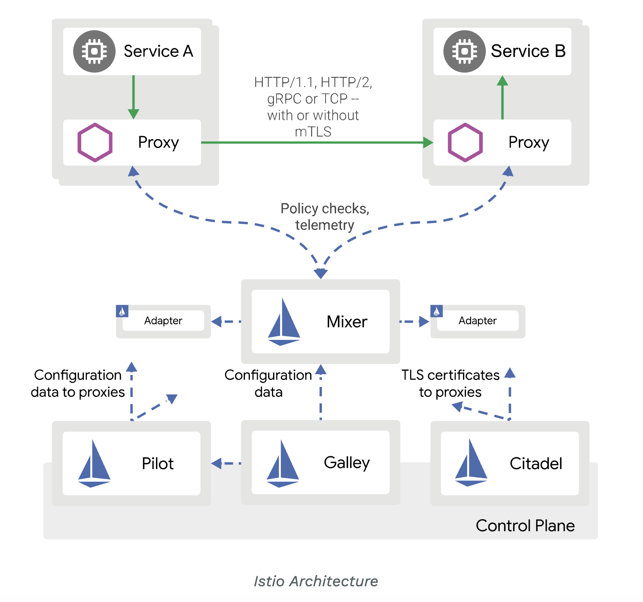
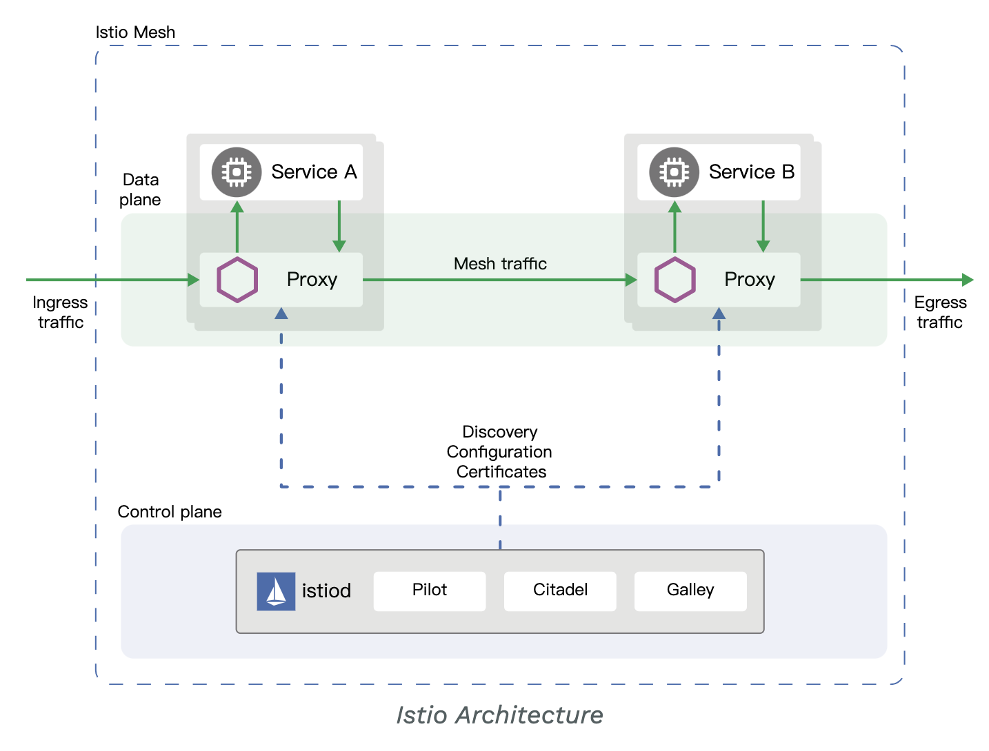
Istio Mesh
Service Discovery
Load balancer
TLS
HTTP/gRPC proxy
Traffic split
Ingress
Rate Limit
Route
Metrics, Tracing, Logs
…
before Istio 1.5
starting with Istio 1.5
https://istio.io/latest/docs/concepts/what-is-istio/

Slide 5
Latency concerns in Istio 1.3
Environment:
8 cores CPU with 70% CPU usage
HTTP/1.1 keep-alive connections with 8000 QPS
Disabled TLS, Mixer Policy
Enabled Telemetry
Enabled Tracing (1%)

Slide 6
Performance Comparison Across Version
Istio adds about 2.8ms to 8ms to the P90 latency.
With 1000 QPS, Envoy uses about 0.5 to 0.6 vCPU.

Slide 7
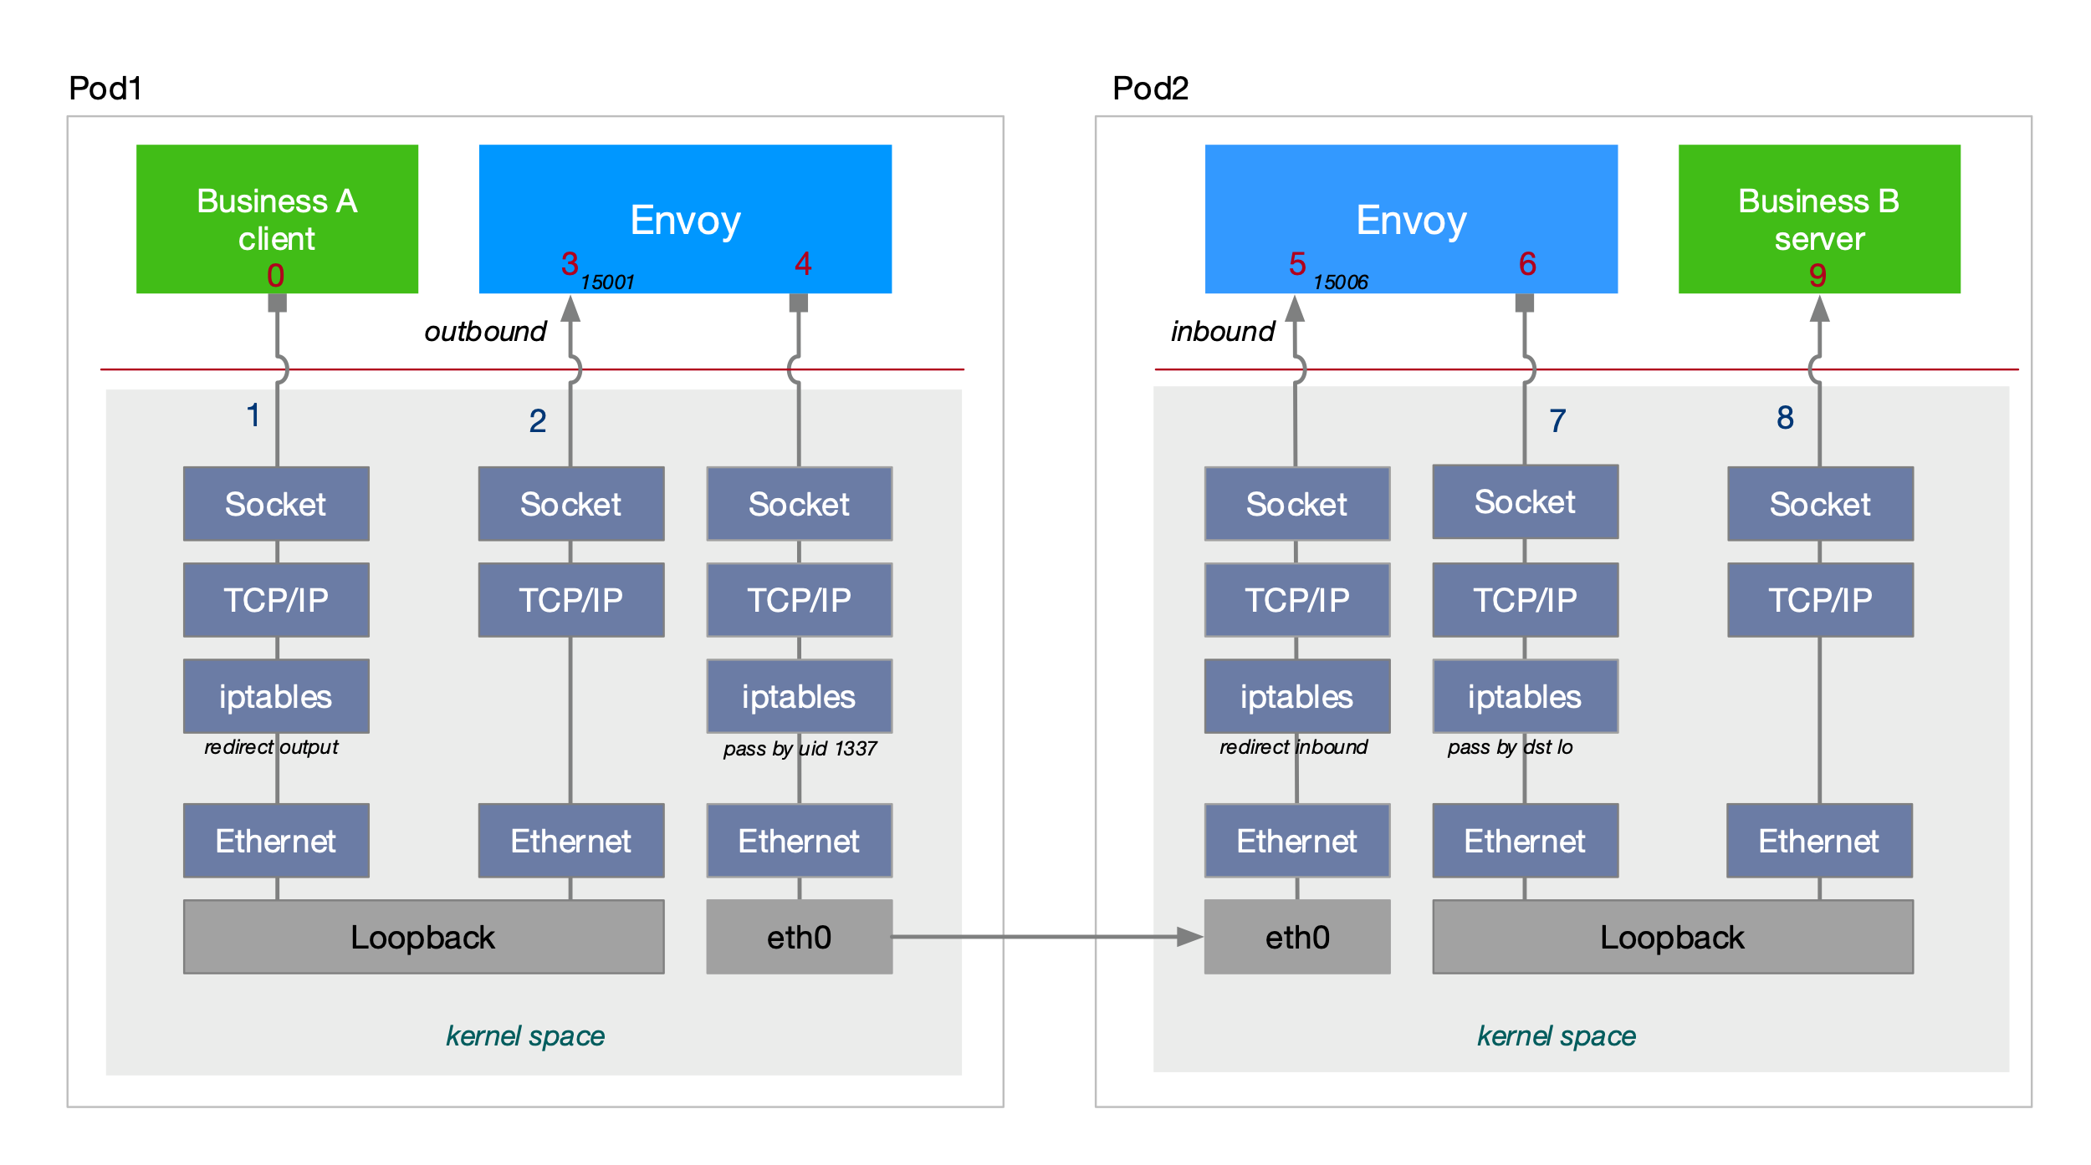
Latency Hotspot

Slide 8
Latency Hotspot

Slide 9
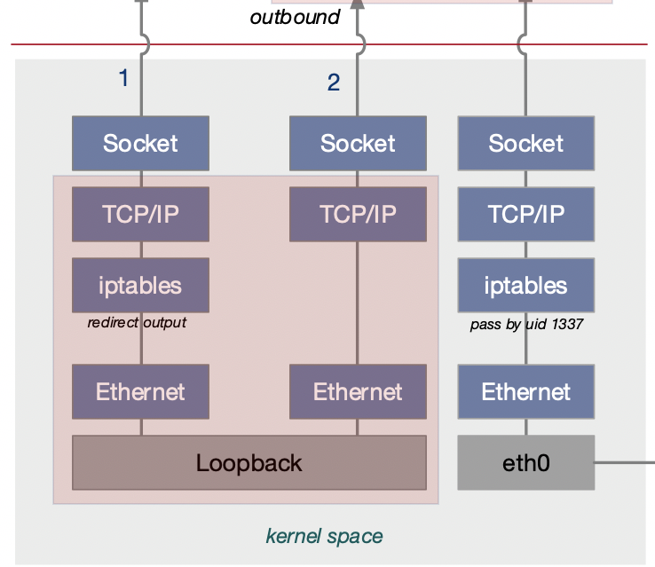
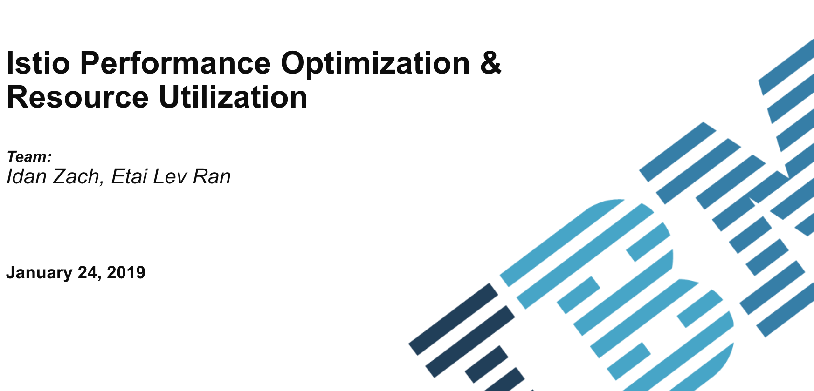
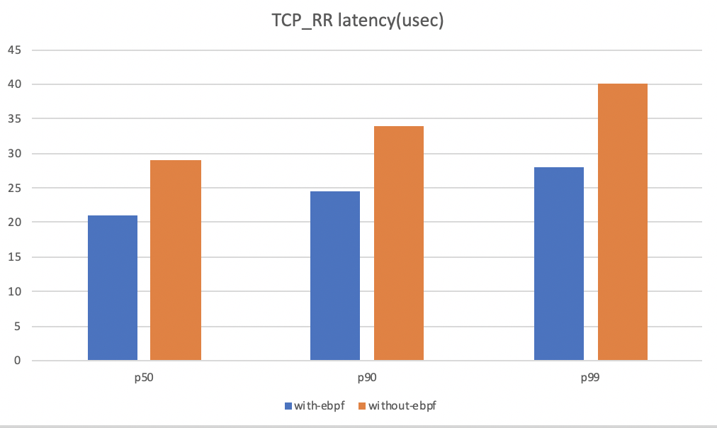

Is It All about the Kernel?
Istio community
preliminary test results on local deployment

Slide 10
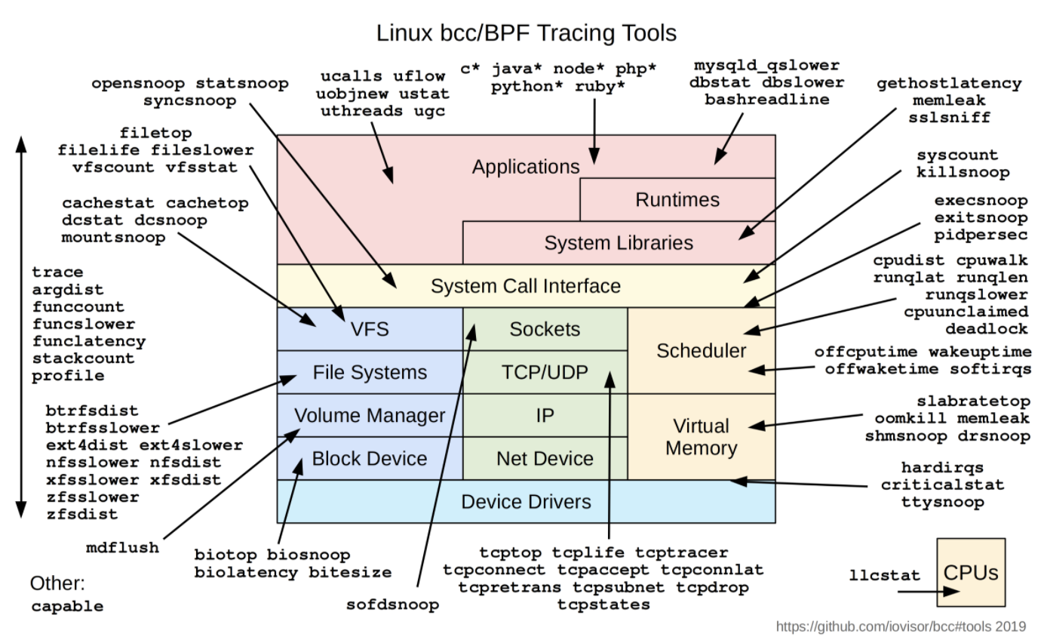
What is eBPF?
eBPF
In-kernel virtual machine
Running user code in kernel space safety
Tracing, security
Networking
Sockhash
Store sock info
SK_MSG prog attach
Kernel proxy

Slide 11
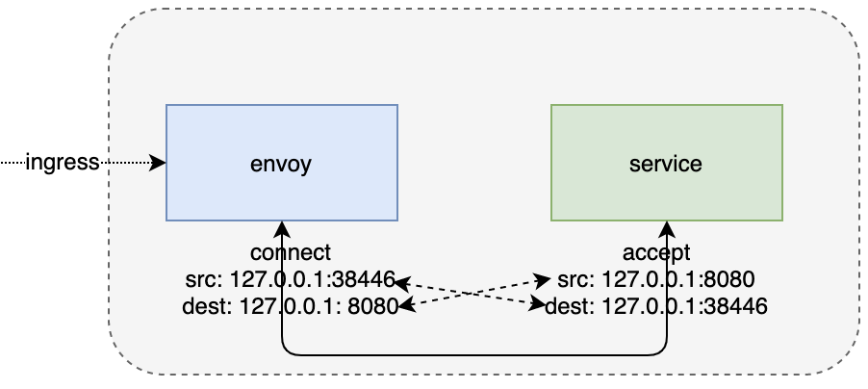
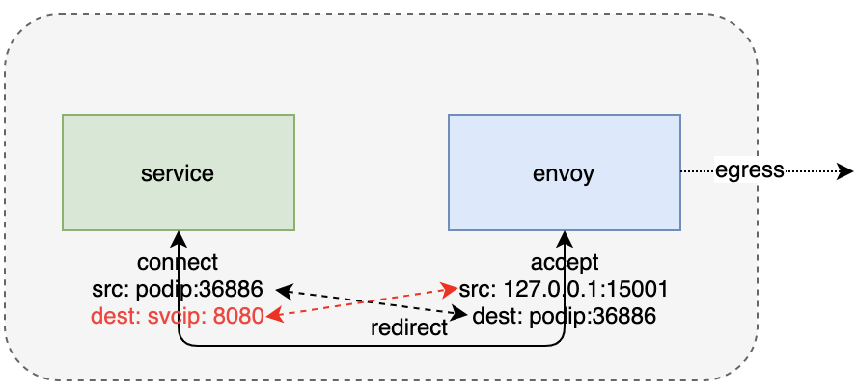
How does eBPF Help?
Sockhash
key | sock
127.0.0.1:38446 127.0.0.1:8080 | envoy_sock1
127.0.0.1:8080 127.0.0.1:38446 | service_sock1
podip:36886 127.0.0.1:15001 | service_sock2
127.0.0.1:15001 podip:36886 | envoy_sock2
ingress side
sock pair
egress side
sock pair

Slide 12
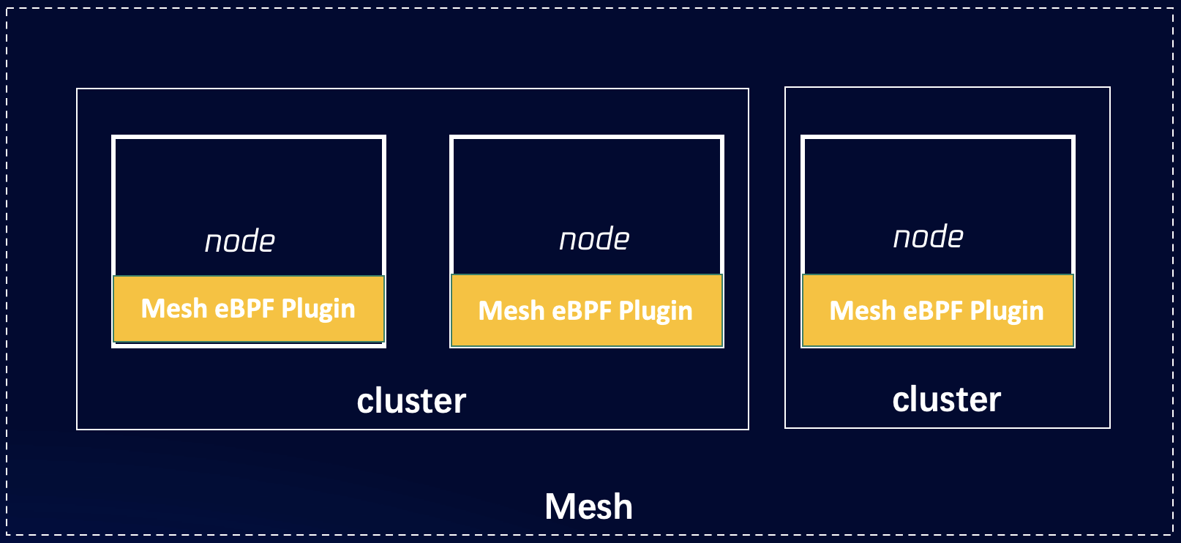
Kernel Acceleration with eBPF
Run as DaemonSet
Decouple with CNI plugin
eBPF plugin
eBPF plugin

Slide 13
Kernel Acceleration Performance Results
Conclusion:
Require kernel version 4.18+
eBPF bugs in kernel
Improvement is not so significant
Only about 5%-8% improvement

Slide 14
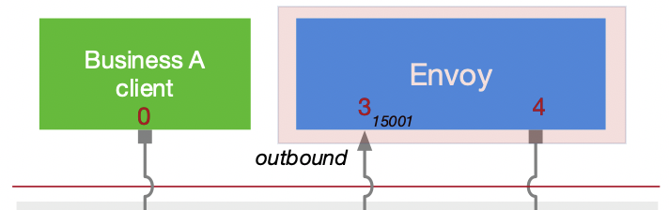
What else we can do?
How about user space optimization?

Slide 15
About Envoy
High performance C++ distributed proxy
“universal data plane” designed for large microservice “service mesh” architectures
Listener/Network filter architecture
HTTP L7 filter architecture
Best in class observability(stats, tracing, logging)
Advanced load balancing
...

Slide 16

Measure Envoy Latency
Problem: How to get Envoy latency to message forwarding process in the Istio data plane?
Client
Request
Envoy
Envoy
Server
Response
?
?
Solution: Record timestamps of the start and end of the message forwarding process by Envoy.
envoy
Request
TCP Read
TCP Write
Performance and Thread Safety Considerations:
Number all messages by adding a unique numeric ID
Use the ID as the index of pre-allocated memory
Stores the timestamps of when messages enter and leave the Envoy in pre-allocated memory
ID
0
1
pre-allocation memory
2
...
...
Response
TCP Write
TCP Read
record timestamp

Slide 17
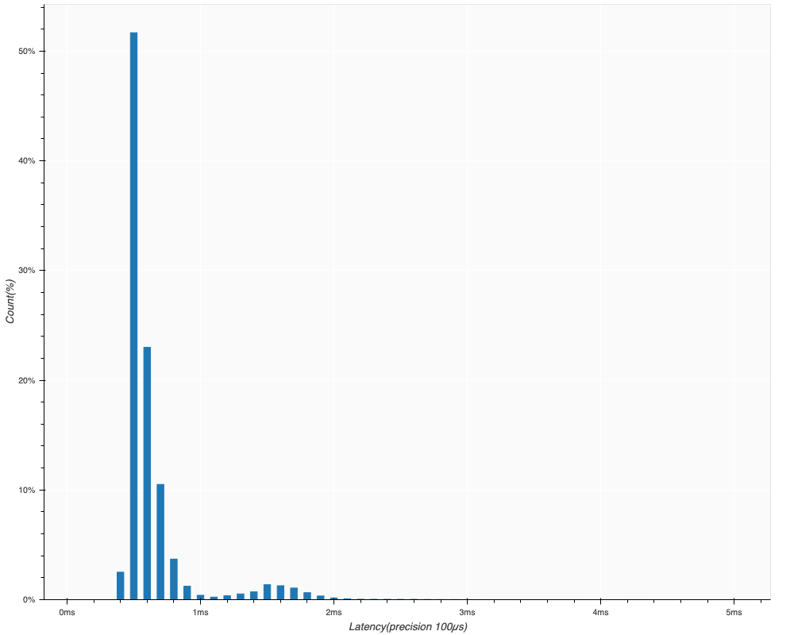
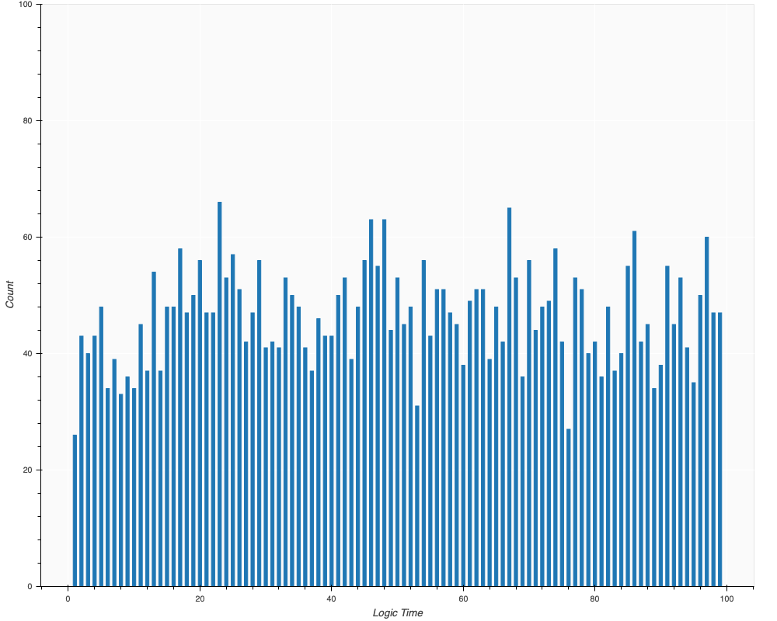
Envoy Latency Data Analysis
High latency occurs throughout the testing process, which is often due to the work thread periodically running some CPU-intensive task, resulting in some messages not being forwarded in a timely manner.
High latency occurs at the tail
High-latency process spread over the entire testing period

Slide 18
Let’s Dig Deeper
Mixer server
mixer server
requests_total{...}: 123
request_duration{...}: 8
Eariler than Istio v1.5 - Istio Mixer Architecture
Envoy Worker Thread
Mixer is a component of Istio for telemetry and other functions. Within Envoy, Mixer extracts the properties of all messages, compresses them in bulk and reports them to the Mixer server.
Attribute Extraction and Compression is a high CPU consuming operation and can cause high latency issues with message forwarding.
Mixer client
reportBatchMaxEntries: 32
reportBatchMaxTime: 1s
Mixer Attribute Extractor
Mixer Batch
Compressor
Request
mixer
cors
fault
router
server
Log
Response

Slide 19
Istio Mixer Telemetry Optimization
Telemetry consumes a lot of CPU, causing the Worker thread to block message forwarding
Telemetry runs in isolated asynchronous threads and does not block Worker threads
We've added some AsyncWorker threads to envoy, specifically to execute non-urgent but more consuming CPU resources for the task. The AsyncWorker thread runs at low priority (SCHED_IDLE) to reduce the impact of scheduling delay on other work threads.
The Worker thread simply places the message data into a high-performance in-memory queue, which AsyncWorker pulls periodically for processing.

Slide 20
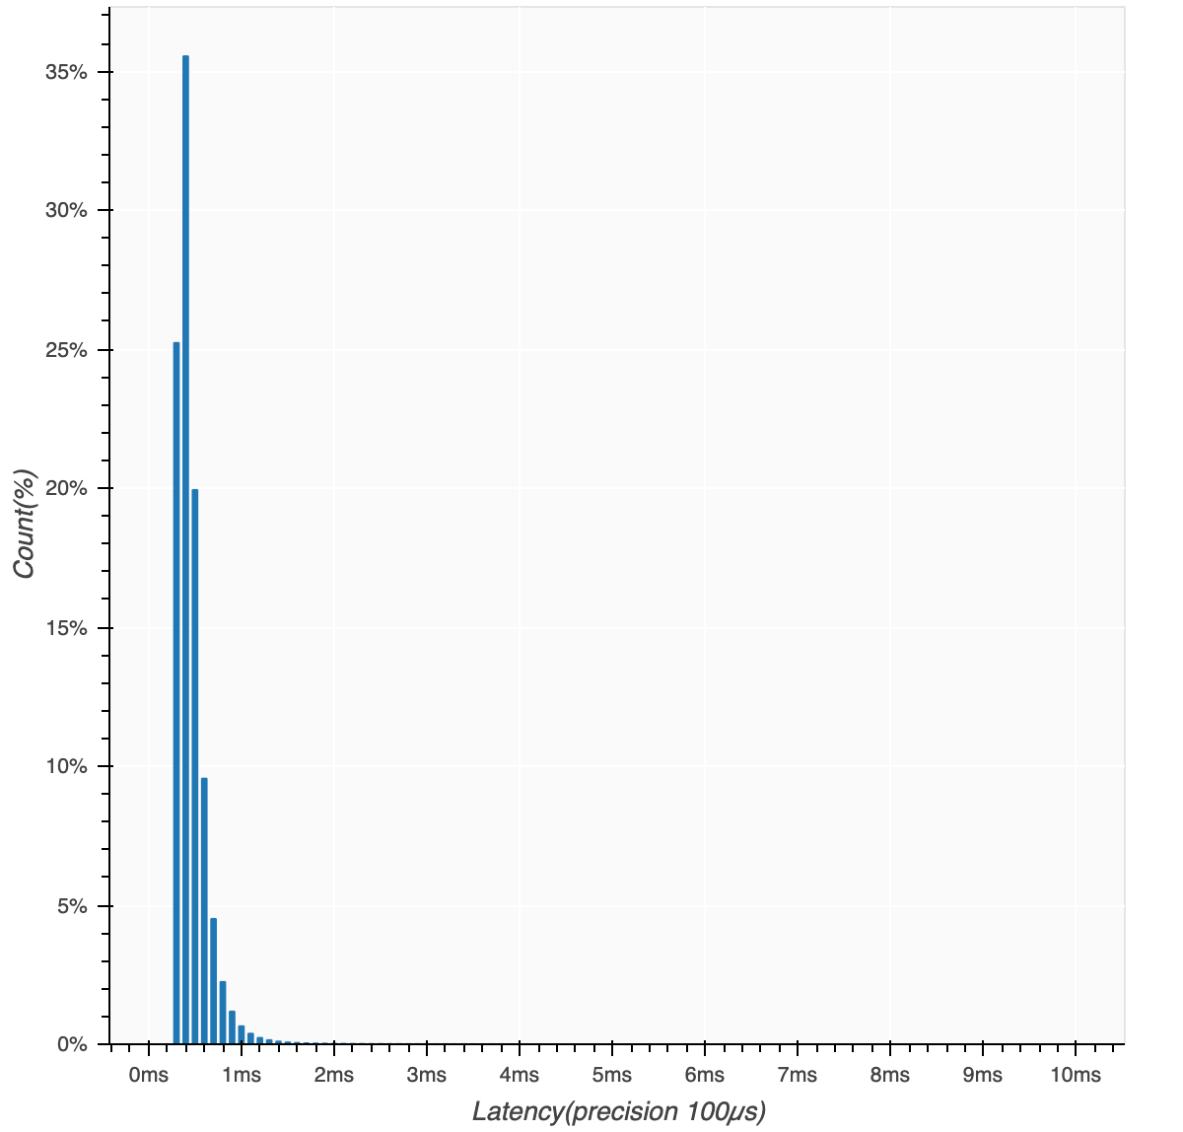
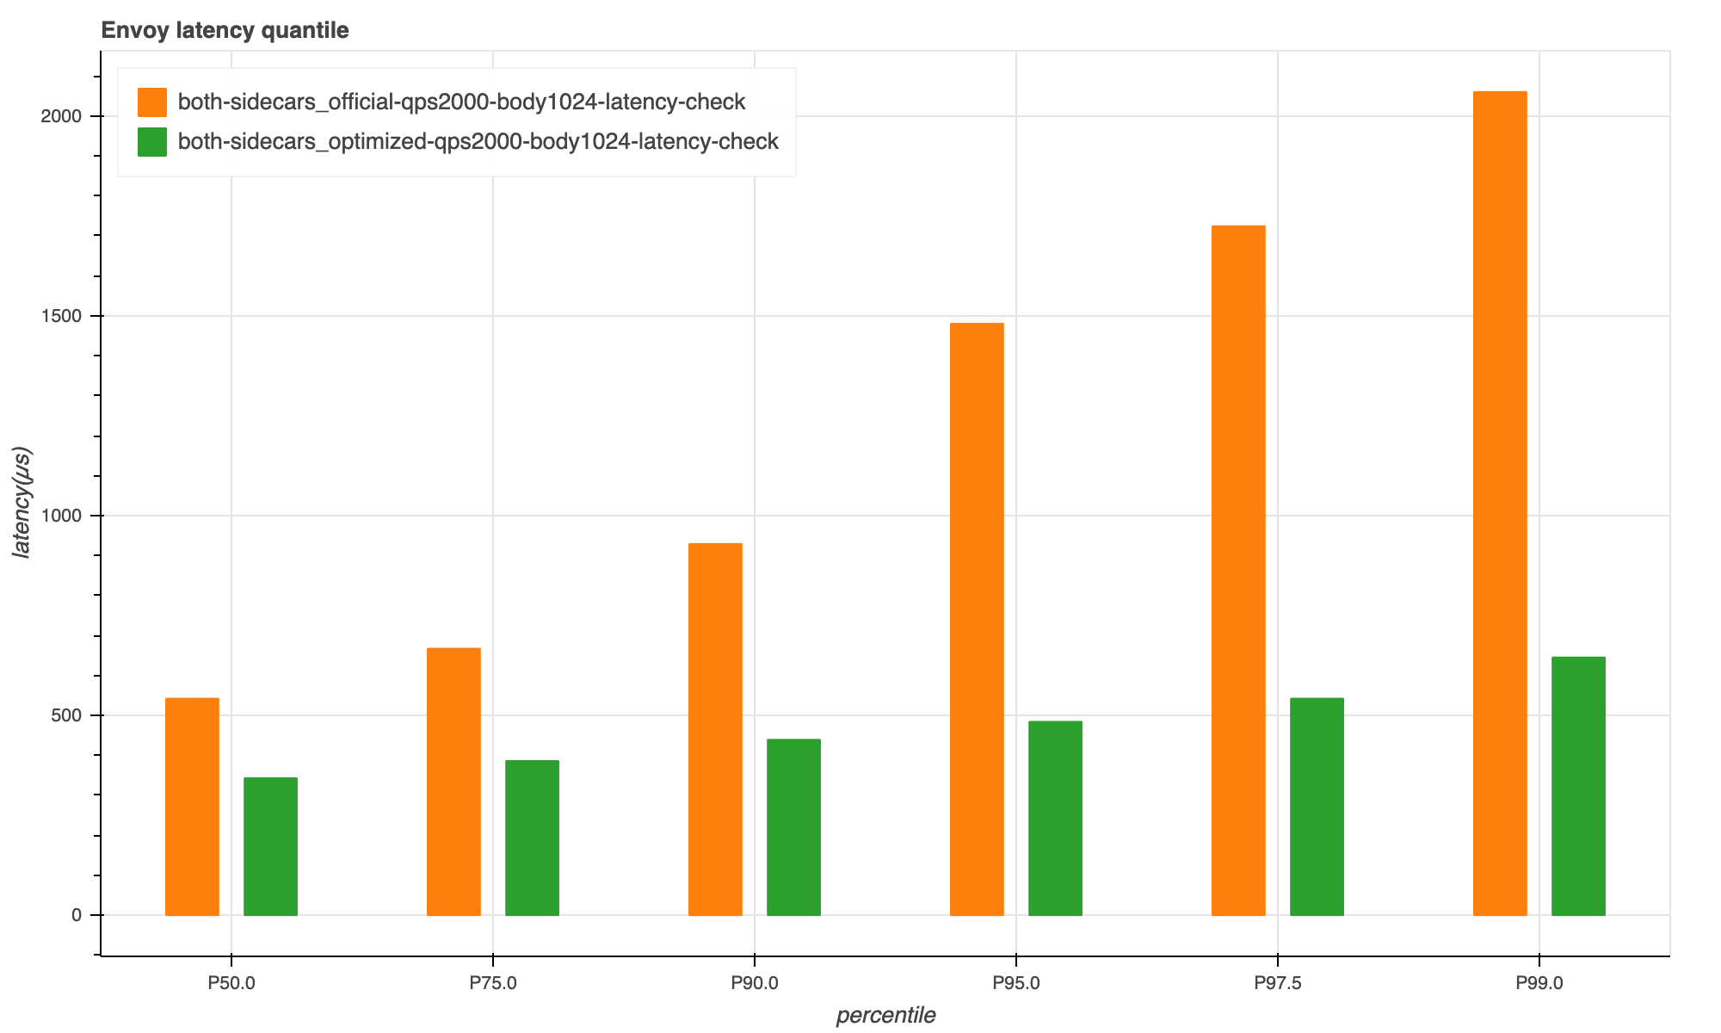
Mixer Telemetry Optimization Result
official
optimized
High latency has disappeared after optimization.
Envoy processing latency is reduced by more than 40% after optimization.

Slide 21
Further thinking
The CPU is a critical resource for the performance of the Istio data plain proxy (envoy).
While architectural optimizations can reduce latency, they don't address the underlying problem, and reducing Envoy CPU usage is the key to optimization
Mixer consumes around 30% of the CPU for the different functional components of Envoy, and telemetry is a core function of Mixer, so optimizing telemetry is important for the future

Slide 22
Istiod Evaluation
Istio 1.5带来的礼物：
We have Telemetry V2 now, Mixer is history!
Released Istio v1.5 - Telemetry V2
image source: https://scarfofsilver.tumblr.com/post/178074461879

Slide 23
Wasm-based Telemetry V2
decodeHeaders()
Envoy Worker Thread
Telemetry v2 generates metric and stores it in Envoy memory, making the store operation very lightweight compared to mixer reporting.
Envoy native(C++) extension
requests_total{...}: 123
request_duration{...}: 8
Wasm VM Runtime
Envoy native(C++) extension
(WASM filter)
proxy_on_http_request_headers()
stats extension
(telemetry)
Proxy-Wasm
Proxy-Wasm
proxy_get_http_request_header("request.uri")
proxy_alloc_memory(size)
...copy value into VM's memory...
proxy_record_metric(metric_id, value)
Envoy native(C++) extension
source: https://docs.google.com/presentation/d/1QMGEuVD9p5iNbzxzgT4p2PXpxg1MjfSbpbJdw6g6Q_Y/edit#slide=id.g62354edd18_1_3193

Slide 24
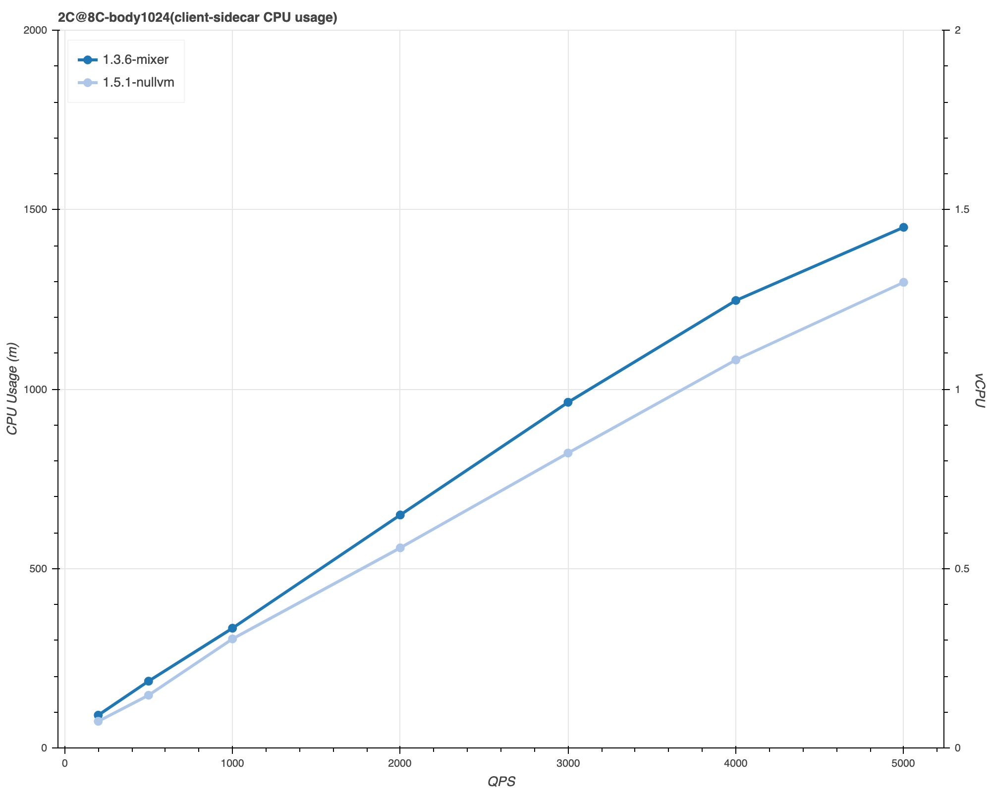
Telemetry V2 vs Mixer Telemetry
The performance of the Telemetry V2 is not too good.
Based on previous experience, we believe that the new scheme should reduce CPU usage by at least 20% compared to mixer.
Telemetry V2 reduces CPU usage by about 10%.

Slide 25
Envoy Wasm Performance Disadvantage (1)
result
Memory copy operation
getValue("request.uri")
0x3BAC
ptr
The Wasm extension can only exchange data with the Host environment via copy (Envoy Wasm NullVM mode is also subject to this restriction)
The Wasm extension needs to perform multiple memory copies to get a property value via the Proxy-Wasm SDK
The Wasm stats extension needs to get multiple Request, Response properties from the Envoy Host environment when calculating metrics
memcpy
vm bufer
getProperty
Copy vm buffer to result (deserialize)
malloc
vm memory
memcpy
host bufer
CEL parse
Copy host buffer to vm buffer,
set ptr and size in vm
value
Resolve Context Value
Copy value to host buffer
(serialize)
host(envoy) memory

Slide 26
Envoy Wasm Performance Disadvantage (2)
Additional overhead from multiple Wasm VMs
envoy
The stats extension to generate telemetry metrics requires support from the metadata_exchange extension to obtain information about the peer node (e.g. service name, version, etc.)
metadata_exchange extensions and stats extensions running in two separate VMs, with node information being passed through Envoy's filterState.
requests_total{...}: 123
request_duration{...}: 8
filterState
generate
Wasm VM
Wasm VM
Request
metadata_exchange extension
stats
extension
Response

Slide 27
How can we improve Telemetry V2 ?

Slide 28

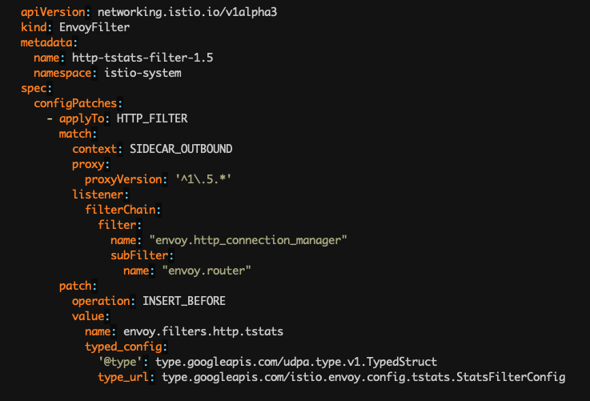
tstats Telemetry Filter
Prometheus
pull metrics
Config by EnvoyFilter CRD:
envoy
requests_total{...}: 123
request_duration{...}: 8
generate
tstats
Request
metadata
exchange
metric
generator
Response
tstats is a high-performance telemetry component implemented by Envoy native extensions.
tstats contains both metadata_exchange and stats functionality, generating compatible telemetry metrics that can replace Wasm stats extensions and reduce Envoy's CPU resource consumption.

Slide 29

tstats Optimize Metric Calculation
Example of metric calculation:
requests_total{destination_app="foo",source_ip="10.0.0.5",response_code="200",destination_version="v2"}: 10
metric_name
dimensions
value
requests_total
Fill dimension fields
requests_total
hashmap
metric key
metric instance
increase(+1)
metrics in memory

Slide 30
tstats Optimize Metric Calculation
Caching node dimensions to reduce the number of dimensions to be populated per request.
local node info
peer node info
requests_total
Fill dimension fields
local node info
peer node info
requests_total
0x61723588
0x8925d371
Only a few fields need to be iterated to calculate the hash value.
(as seed)

Slide 31
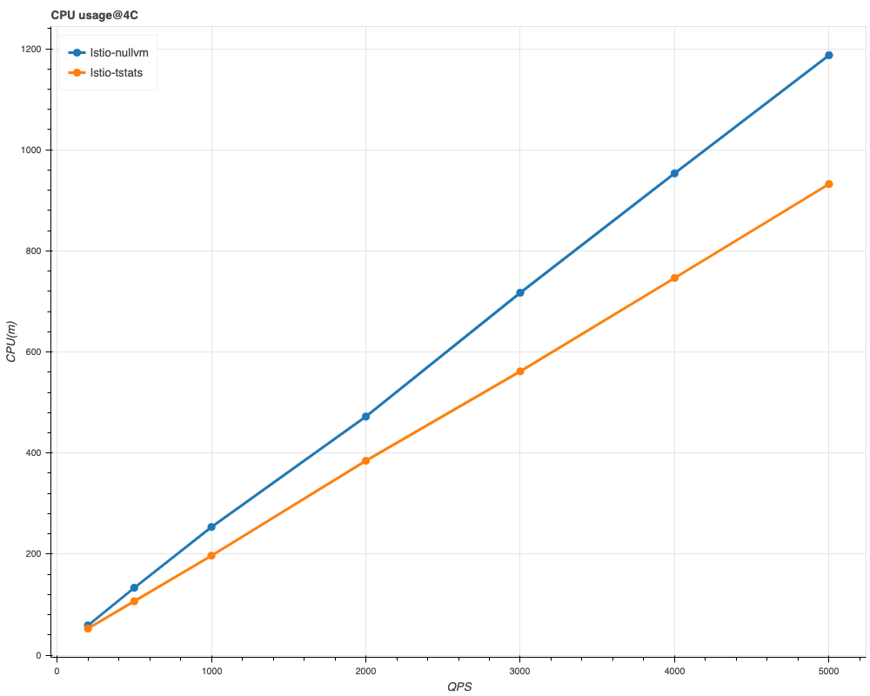
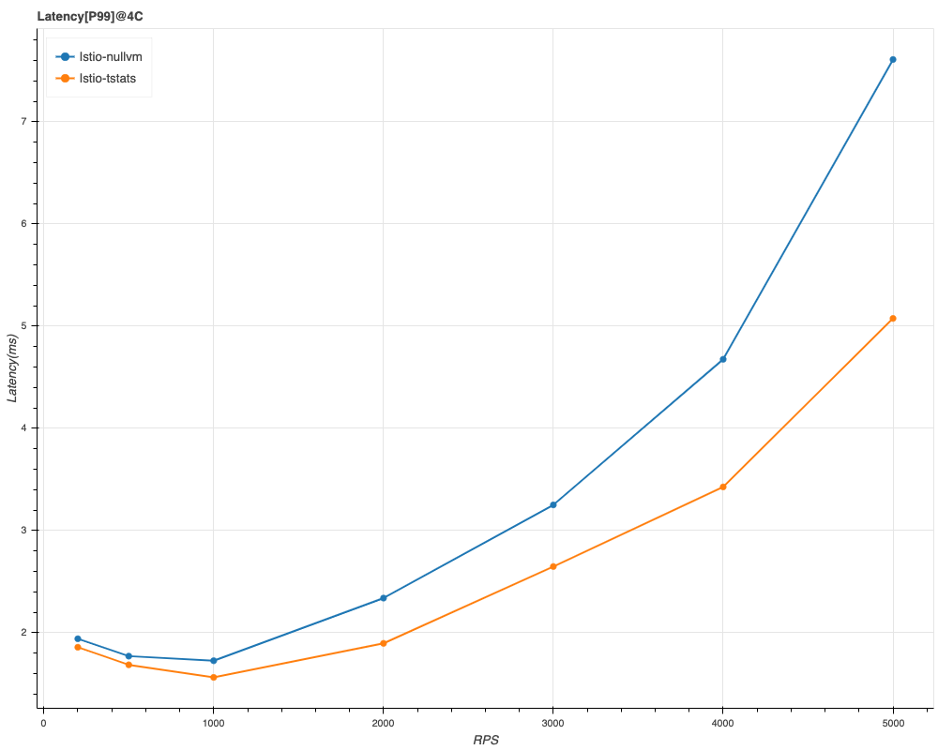
tstats Optimization Results
Envoy CPU usage is reduced by 15% to 20% with tstats compared to Wasm-based stats extension.
With tstats, the P99 latency is reduced by 20% to 40%.
(echo service benchmark)

Slide 32
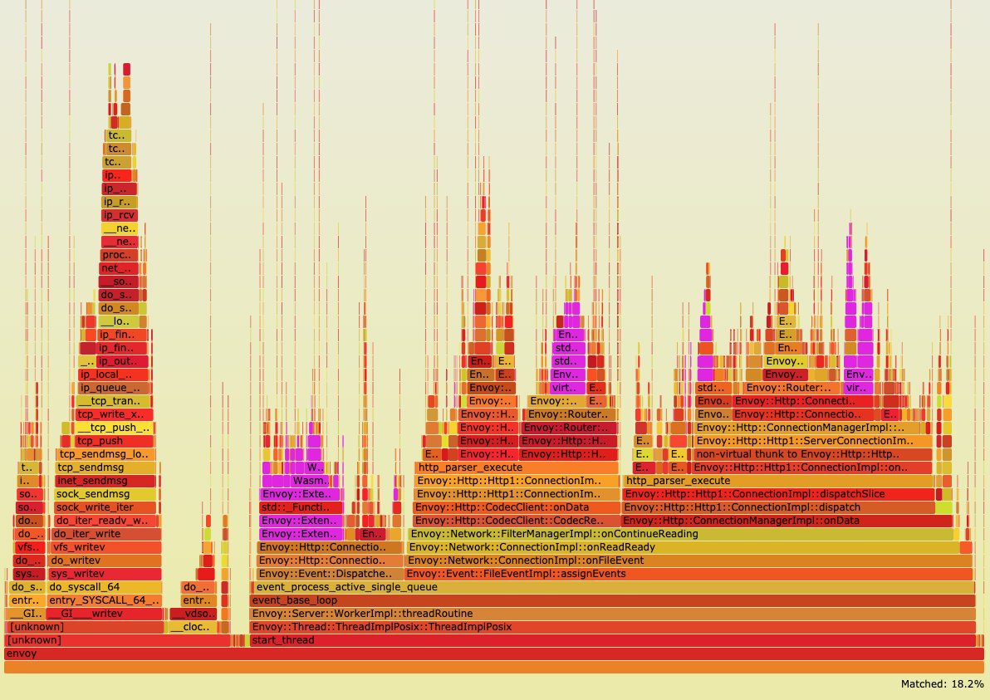
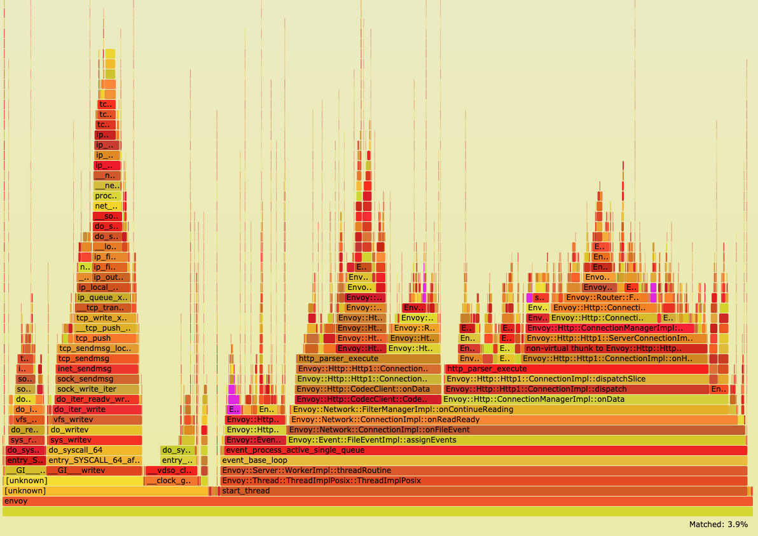
tstats Optimization Results
Wasm-based stats extension uses significantly more CPU.
tstats telemetry uses significantly less CPU

Slide 33
Future Works
XDP-based host network accelerating
Optimize resource usage by Tracing
Optimize Envoy built-in statistical metrics

Slide 34

Learn more about TCM
Keep updated with Tencent Cloud Native Products and Technical Deep Dives
Thanks!

